Slide 1

Indian Dowry System: From Tradition to Tragedy
The Indian dowry system, a practice with roots in historical customs, has tragically evolved into a societal ill. What once may have served as a form of inheritance for daughters, providing them with economic security in their marital home, has become a means of exploitation and a source of immense pressure for families, often leading to devastating consequences. This presentation explores the journey of the dowry system in India, from its historical context as a voluntary tradition to its devastating modern reality as a tool for extortion, examining its far-reaching impact on individuals, families, and the ongoing efforts to eradicate this harmful practice.

Slide 2

Historical Context: Dowry's Evolution in India
The practice of dowry can be traced back to ancient India, although its original form differed significantly from the modern-day system. Initially, it was seen as a voluntary gift given to the bride by her family, intended to provide her with economic security and independence in her marital home. Over time, however, this voluntary custom gradually transformed into a compulsory demand imposed on the bride's family by the groom's family. This shift was influenced by factors such as patriarchal societal structures and the growing emphasis on material wealth. This transition has resulted in significant social and economic consequences for women and their families across the country.

Slide 3

The Traditional Perspective: Shifting Societal Norms
In traditional Indian society, the dowry was often rationalized as a way to compensate the groom's family for the perceived financial burden of taking on a new member. It was also seen as a means of ensuring the bride's social status and providing her with resources to establish her new household. However, these traditional perspectives have become increasingly outdated and problematic in the face of changing societal norms. The emphasis on dowry as a measure of a bride's worth has perpetuated gender inequality and placed immense pressure on women and their families.

Slide 4

The Modern Reality: Dowry's Perversion and Abuse
The modern dowry system in India is characterized by escalating demands and horrifying abuses. No longer a voluntary exchange, it has become a brutal transaction where the groom's family demands exorbitant sums, luxury vehicles, and even prime real estate. Failure to meet these demands can result in horrific consequences for the bride. Examples of abuse include: systematic emotional harassment and isolation, physical violence disguised as domestic discipline, and, in the most extreme cases, bride burning and dowry deaths, where women are murdered to free the groom for another dowry. This perversion of tradition perpetuates a vicious cycle of exploitation, leaving countless women vulnerable to violence and injustice.

Slide 5
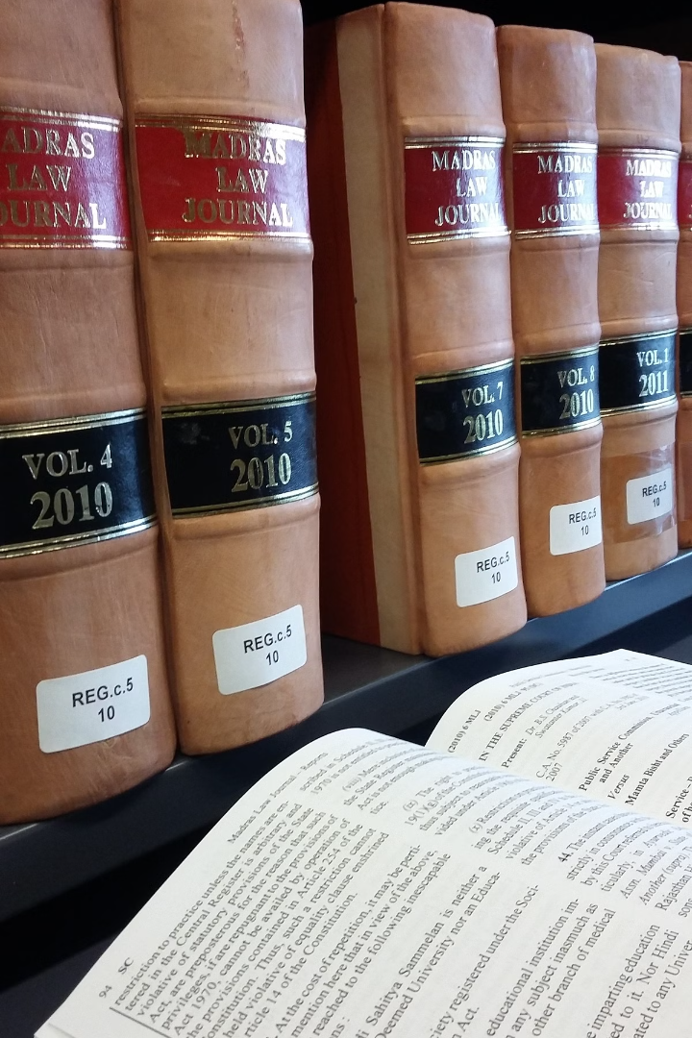



The Legal Framework: Laws Against Dowry Harassment

Slide 6
The Dowry Prohibition Act of 1961
The Dowry Prohibition Act of 1961 prohibits the giving, taking, or demanding of dowry.

Slide 7
Section 498A of the Indian Penal Code
Section 498A of the Indian Penal Code criminalizes dowry harassment, providing for imprisonment and fines for those found guilty of subjecting a woman to cruelty in connection with dowry demands.

Slide 8
Enforcement Challenges
Despite these legal provisions, enforcement remains a significant challenge, and many cases of dowry abuse go unreported due to social stigma and fear of reprisal.

Slide 9

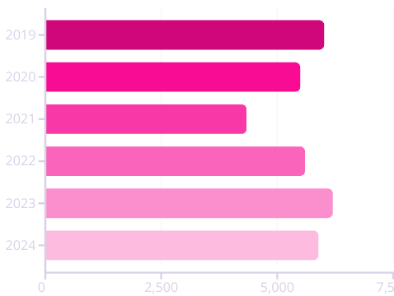
The Psychological Impact: Trauma and Mental Health
The dowry system inflicts profound psychological trauma on women who are subjected to its pressures and abuses.
The constant fear of not meeting dowry demands, the experience of harassment and violence, and the sense of being devalued and objectified can lead to severe mental health problems, including depression, anxiety, post-traumatic stress disorder (PTSD), and suicidal ideation.
The psychological impact of the dowry system extends beyond individual victims, affecting their families and communities as well.
Addressing the mental health needs of dowry abuse survivors is crucial for their healing and recovery.
These mental health challenges often manifest as difficulty in forming healthy relationships, low self-esteem, and a pervasive sense of hopelessness.
Furthermore, the social stigma associated with dowry-related issues can prevent many women from seeking the help they desperately need.
It's essential to provide comprehensive mental health support, including counseling, therapy, and safe spaces, to help these women overcome the trauma and rebuild their lives.

Slide 10
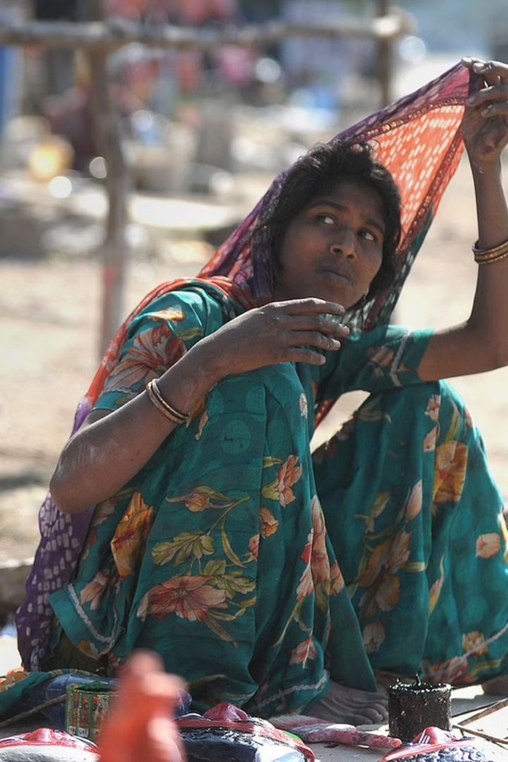
Socioeconomic Factors: Poverty and Dowry Demands
Poverty and economic inequality exacerbate the dowry system, particularly in rural areas and marginalized communities. Families struggling to make ends meet may feel compelled to demand dowry as a means of improving their financial situation. The pressure to provide a substantial dowry can push families into debt and further impoverish them. Addressing socioeconomic disparities and providing economic opportunities for women are essential steps in reducing the demand for dowry and empowering women to resist this harmful practice. Education and awareness programs can also play a critical role in challenging traditional attitudes towards dowry and promoting gender equality.

Slide 11

Case Studies: Stories of Victims and Survivors
Numerous case studies shed light on the tragic realities of the dowry system and the experiences of its victims. These stories reveal the diverse forms of abuse and violence that women face, including physical assault, emotional manipulation, and financial exploitation. They also highlight the resilience and strength of survivors who have managed to escape abusive situations and rebuild their lives. By sharing these stories, we can raise awareness about the devastating impact of the dowry system and inspire action to prevent future tragedies.

Slide 12
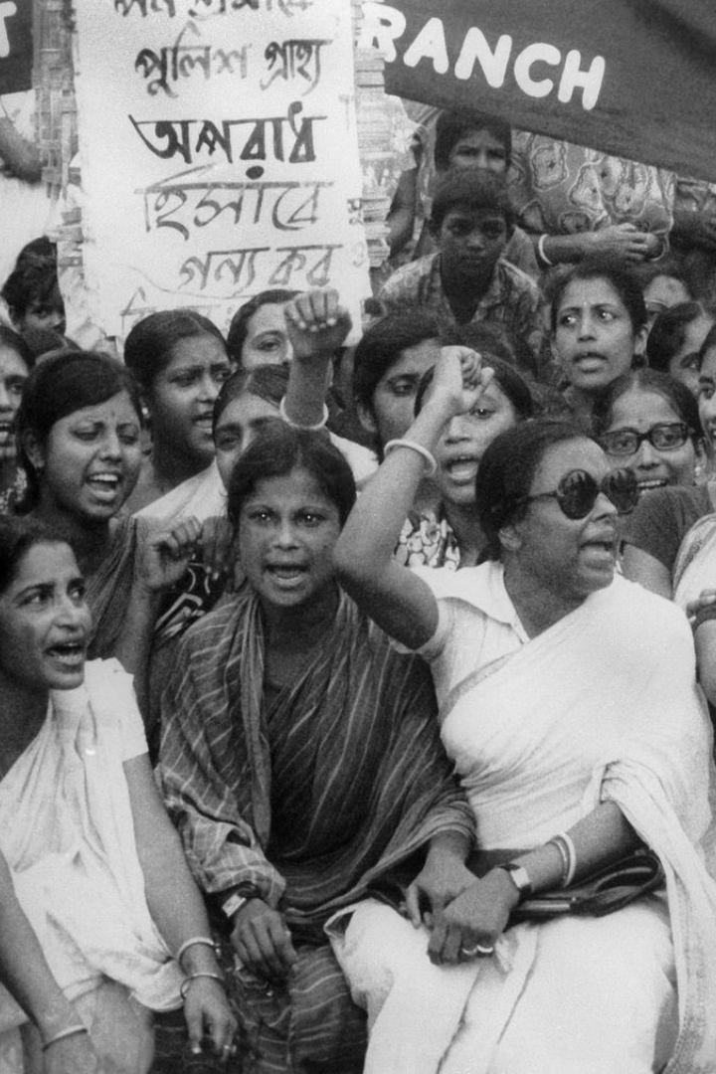
The Fight for Change: Activism and Social Reform
Numerous organizations and activists are working to eradicate the dowry system and promote gender equality in India. These efforts include raising awareness about the issue through education campaigns, providing support and resources to dowry abuse survivors, advocating for stronger enforcement of anti-dowry laws, and challenging traditional attitudes towards dowry and women's roles in society. Social reform movements are also working to empower women economically and politically, enabling them to resist dowry demands and assert their rights. The fight for change requires a multifaceted approach that addresses the root causes of the dowry system and promotes a more just and equitable society.

Slide 13
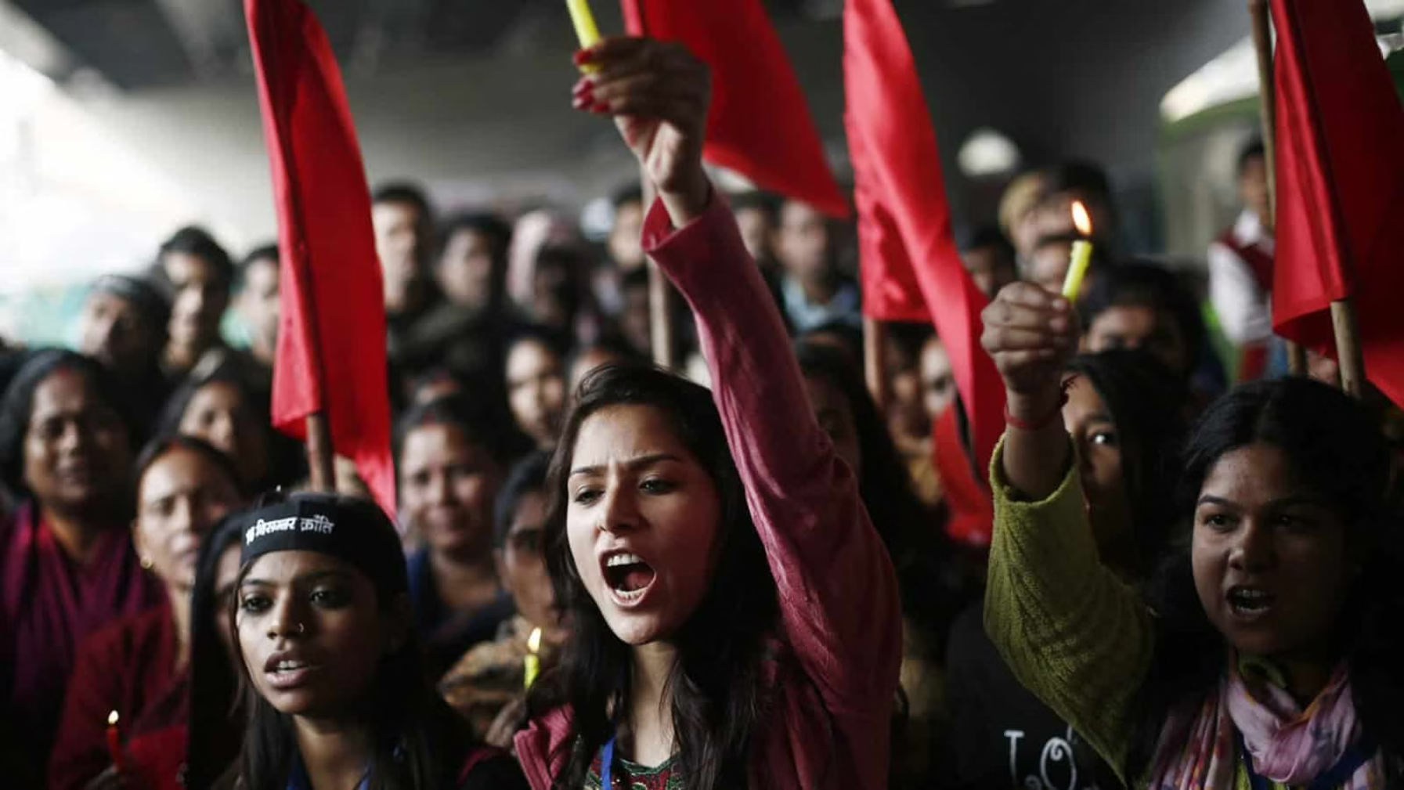
Conclusion: Hope for a Dowry-Free Future
While the Indian dowry system remains a significant challenge, there is hope for a dowry-free future. By continuing to raise awareness, enforce anti-dowry laws, empower women economically and politically, and challenge traditional attitudes, we can create a society where women are valued for their contributions and are free from the pressures and abuses of the dowry system. Achieving this vision requires a collective effort from individuals, communities, governments, and organizations working together to promote gender equality and social justice.

